Slide 1
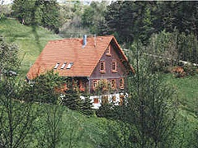
Mein Haus
Donnerstag, den 12. März
Objective: To add more detail and write about what our house is like.

Slide 2
DIE FARBEN
ORANGE
ROSA
ROT
BRAUN
GRAU
GRÜN
WEISS
GELB
BLAU
LILA
SCHWARZ

Slide 3
DIE FARBEN
ORANGE
ROSA
ROT
BRAUN
GRAU
GRÜN
WEISS
GELB
BLAU
LILA
SCHWARZ

Slide 4
Mein ideales Haus
You’ve won the lottery and bought a new house! Write a paragraph (at least 3 sentences) to say what your perfect house is like.
Include:
What kind of house it is.
Where it is.
What size and colour it is.
What it looks like/what it has in it.

Slide 5
Was hast du heute gelernt?
5 types of house
4 locations
3 sizes
2 features of a house
1 colour

